Slide 1
TEAM GOOGLE
THOMAS OKORO
NATALIA VARELA
ETRA ALMANDANI

Slide 2
PLAN OF PRESENTATION
CONTEXT
PROBLEMATIC
BASE RATE
DATA VISUALIZATION (EDA)
DATA CLEANING
MODEL TESTING
RESULTS
Notes:
what is it for

Slide 3
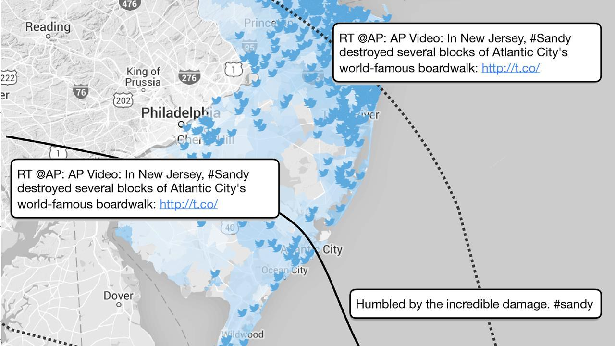
CONTEXT
Twitter can predict hurricane damage as well as emergency agencies…
People rely more on social media app like Twitter to communicate about real time event.
Building an accurate model using text analytics could save lifes and limit financial lost during a disaster.
Sometimes, building some complexe meteorological model is costly and less useful than simply use Machine learning on text analytics..

Slide 4
CONTEXT
Why using Twitter ?
500 million tweets / day
Twitter provide an API
Notes:
use by media

Slide 5
PROJECT PROBLEMATIC
Twitter has become an important communication channel in times of emergency.
However is not always clear if persons words are announcing a disaster.
The ubiquitousness of smartphones enables people to announce an emergency they’re observing in real-time.
Because of this, more agencies are interested in programatically monitoring Twitter (i.e. disaster relief organizations and news agencies).
Notes:
For now we could focus on doing a video as Etra suggested.
First we will start with a video showing that we are using twitter to show how

Slide 6
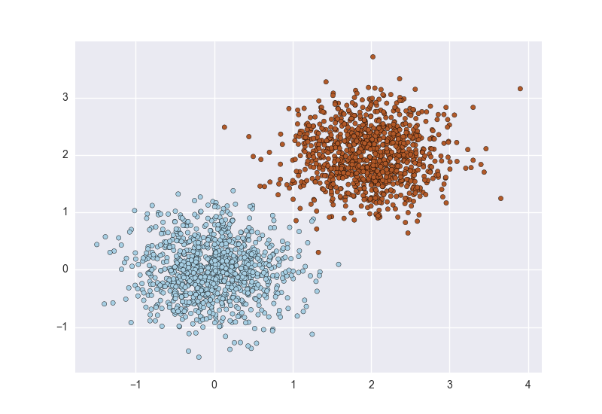
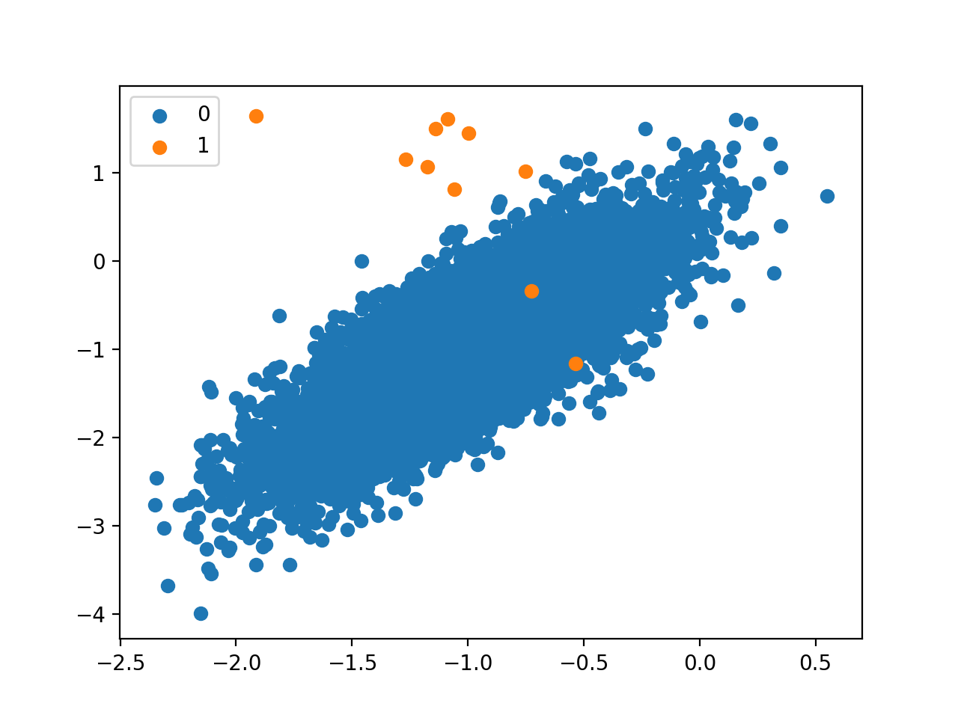
BASE RATE AND PRECISION
Definition : frequency of the most common class
It represent the accuracy if we classify each Tweets in “not a disaster”
It is as if we use no sophisticated classifier, the most simple configuration
A classifier must at least beat the base rate
If the base rate is high, the accuracy potential improvement is lower
low base rate, easiest configuration for classification
high base rate, the precision will be lower

Slide 7
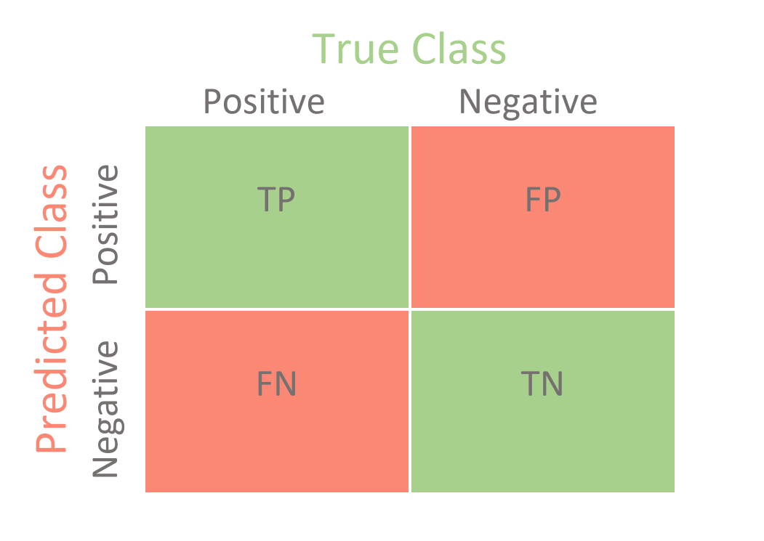
BASE RATE AND PRECISION
ACCURACY NOT EQUAL PRECISION OF A CLASSIFIER
Precision = TruePositives / (TruePositives + FalsePositives)
Accuracy = (True positives + True Negatives) /(TP+FP+TN+FN)
Issues : a high accuracy is good but not sufficient to conclude that a classifier is efficient. If we focus on these two scatterplot, which classifier seems to be more accurate ? And more precise ?
A classifier could have a high accuracy but a low precision and therefore not very useful it could be the case in scatterplot B. We classify an individual in class blue with 99% of accuracy but we miss classify the orange class in 50% of the cases.
A
B

Slide 8


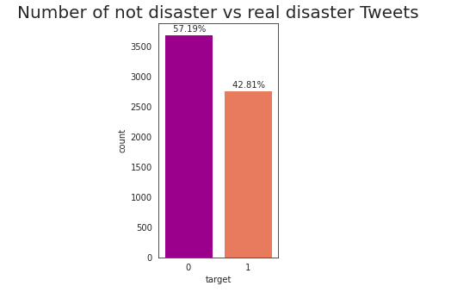
BASE RATE
The base rate represent the frequency of the most common class.
The base rate we obtained based on the data was 57,19%.
Notes:
Meaning that if we use a naive classifier where we just classify each Tweets in the "not a disaster" class

Slide 9
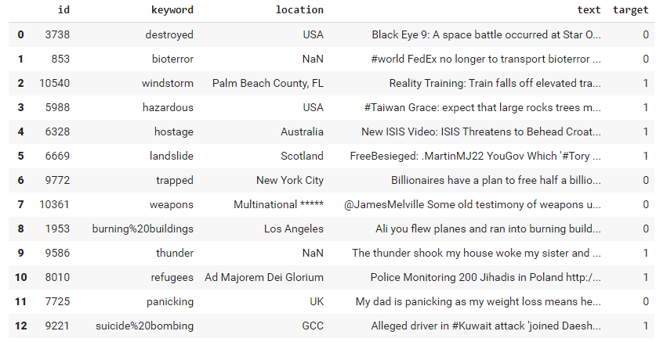
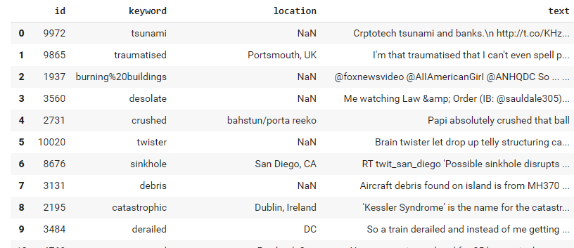
EDA (DATA VISUALIZATION)
Datasets of Tweets :
LABELED training set (6471, 5)
UNLABELD real dataset (1142, 4)
Notes:
Present the two dataset,
Training → labeled vs real data are unlabeled, we want to maximize model accuracy and precision on the training set in order so use the model with real unlabeled data.

Slide 10
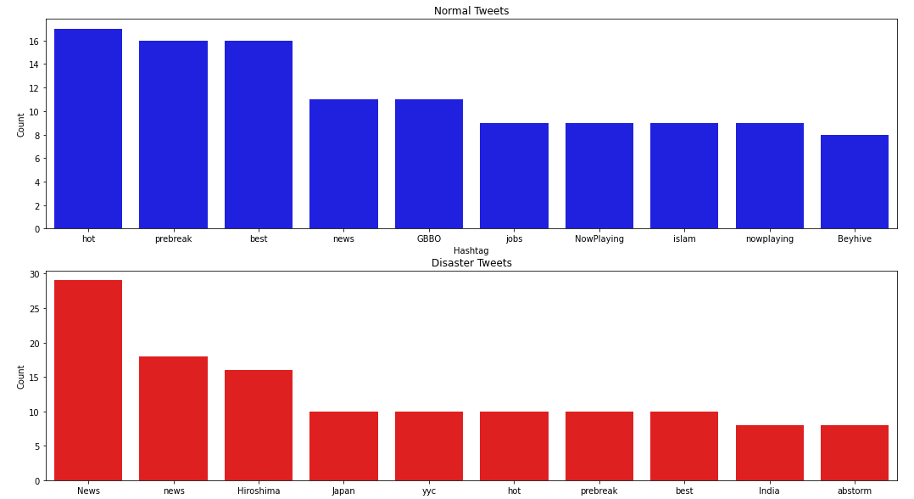
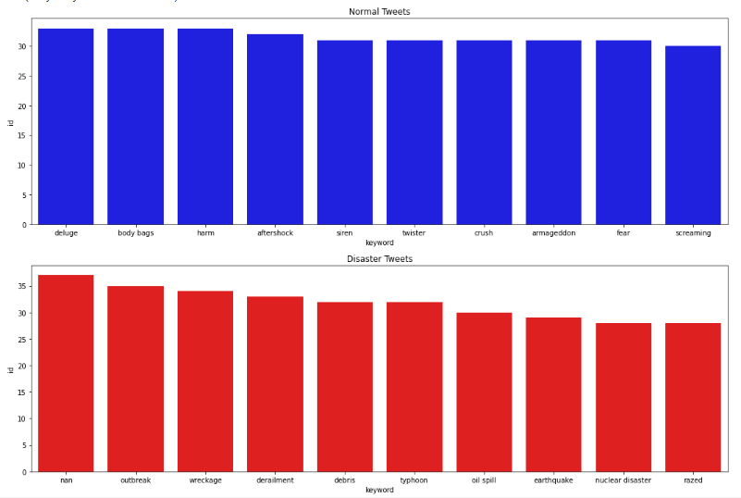
EDA (DATA VISUALIZATION)
Top 10 keywords mostly use in each category
Top 10 hashtags mostly use in each category
Notes:
We can imagine that keywords have an impact on the classifier → this variable should be include in the model
We can imagine that hashtags have an impact on the classifier → this variable should be include in the model

Slide 11
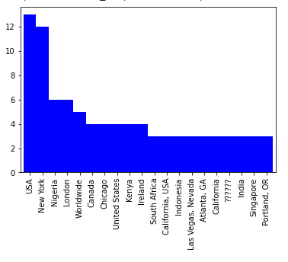
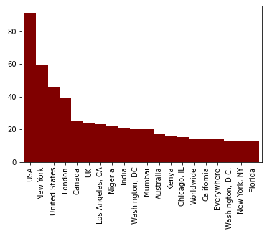
EDA (DATA VISUALIZATION)
Top 20 Tweets location training set
Top 20 Tweets location test set
Most Tweets are from US
Location could have an impact on the accuracy since probability differ a lot from a country to another
Drawback, in fact predict disaster using Tweets work only in region where Twitter is sufficiently used and rely on other factors as : network availability and smartphone equipment
Issue : build a more universal model taking into account multiple languages.
Notes:
location variable may be correlated with disaster → we have to consider location

Slide 12
DATA CLEANING (colab)
We used a Basic cleaning process as hashtags, stop words, lemmatization and punctuation removing and we use tokenization and spacy function to clean our text.
And TF-TDF vectors after cleaning to create vectors that predict most relevant words.

Slide 13
DATA CLEANING (text analytics)
We will use Spacy and Gensim
In python we generally use 5 main libraries :
NTLK
TextBlob
Standform CoreNLP
Spacy
Gensim
Further details on : https://elitedatascience.com/python-nlp-libraries

Slide 14
BASIC MODEL
How to improve ?
Data : cleaned Tweets using spacy
Algorithm : Logistic regression
First accuracy (training) : 0.8216
Notes:
Cross validation can increase the accuracy of a model by that capturing most of the patterns from the data and by not picking up too much on the noise

Slide 15
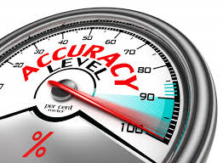
MODEL IMPROVEMENT
Improve accuracy :
Improve cleaning process
Add features in the explanatory variable
Use cross validation
Use N-grams (order of word in a document)
Try other classier (KNN, random forest, Tree,etc..)

Slide 16

MODEL IMPROVEMENT
Improve Cleaning process
Remove hyperlinks
Remove %20 in ‘keywords

Slide 17
MODEL IMPROVEMENT
2. Add features in the explanatory variable
Add location : a location where disaster are more frequent could have more tweets that describe a real disaster.
Add Keywords : since we labelize keywords, they could be a predictor of the dependant variable
Tweets length : The more long in a Tweet, the more the author want to share details. We can think that a longer tweet could be more relevant than a short tweet in the case of disaster announcement.

Slide 18
MODEL IMPROVEMENT
3. Use cross validation : colab
4. Use N-grams (order of word in a document) : colab
5. Try other classifier (KNN, random forest, Tree,etc.) : colab

Slide 19
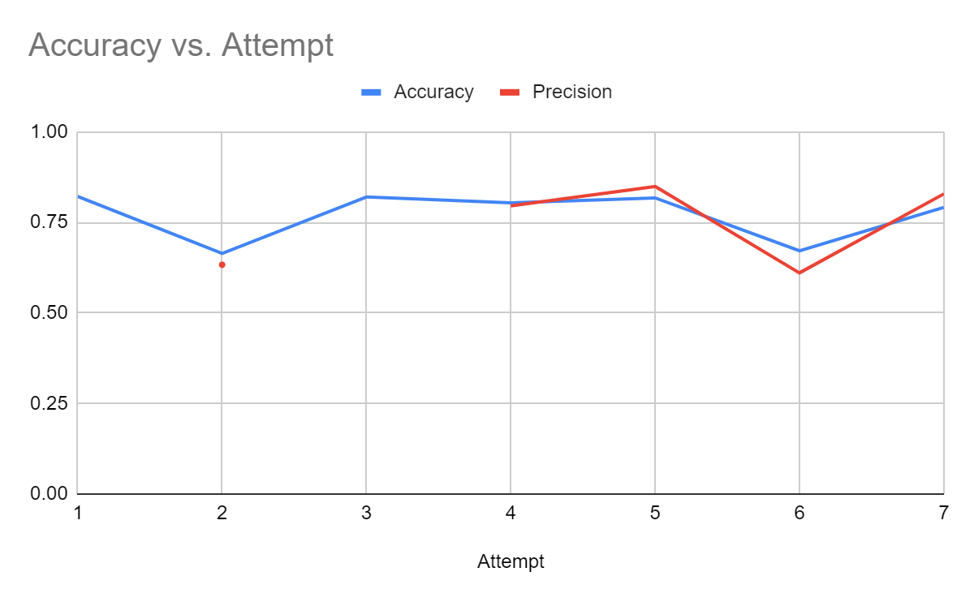
RESULTS ACCURACY MAP
Basic logistic + spacy tokenizer + TF-IDF
Decision Tree
Improve text cleaning (remove url and hashtag)
Cross validation + logistic
N-grams config (1,3)
KNN
Random forest
And the winner is.. number 1 with an accuracy of 0.8216 on the training set
Notes:
here we will put our different accuracy

Slide 20
RESULTS Conclusion
Deal with complexity.
Model accuracy is not the only target.
Keep it simple.
Generalization.
Notes:
Adding complexity does not mean improve accuracy “keep it simple”
Computing time increase with complexity, in practise it is a cost
The accuracy should not be the only way to evaluate a model other statistical parameter has to be considered.
To generalize we should include other languages

